Slide 1

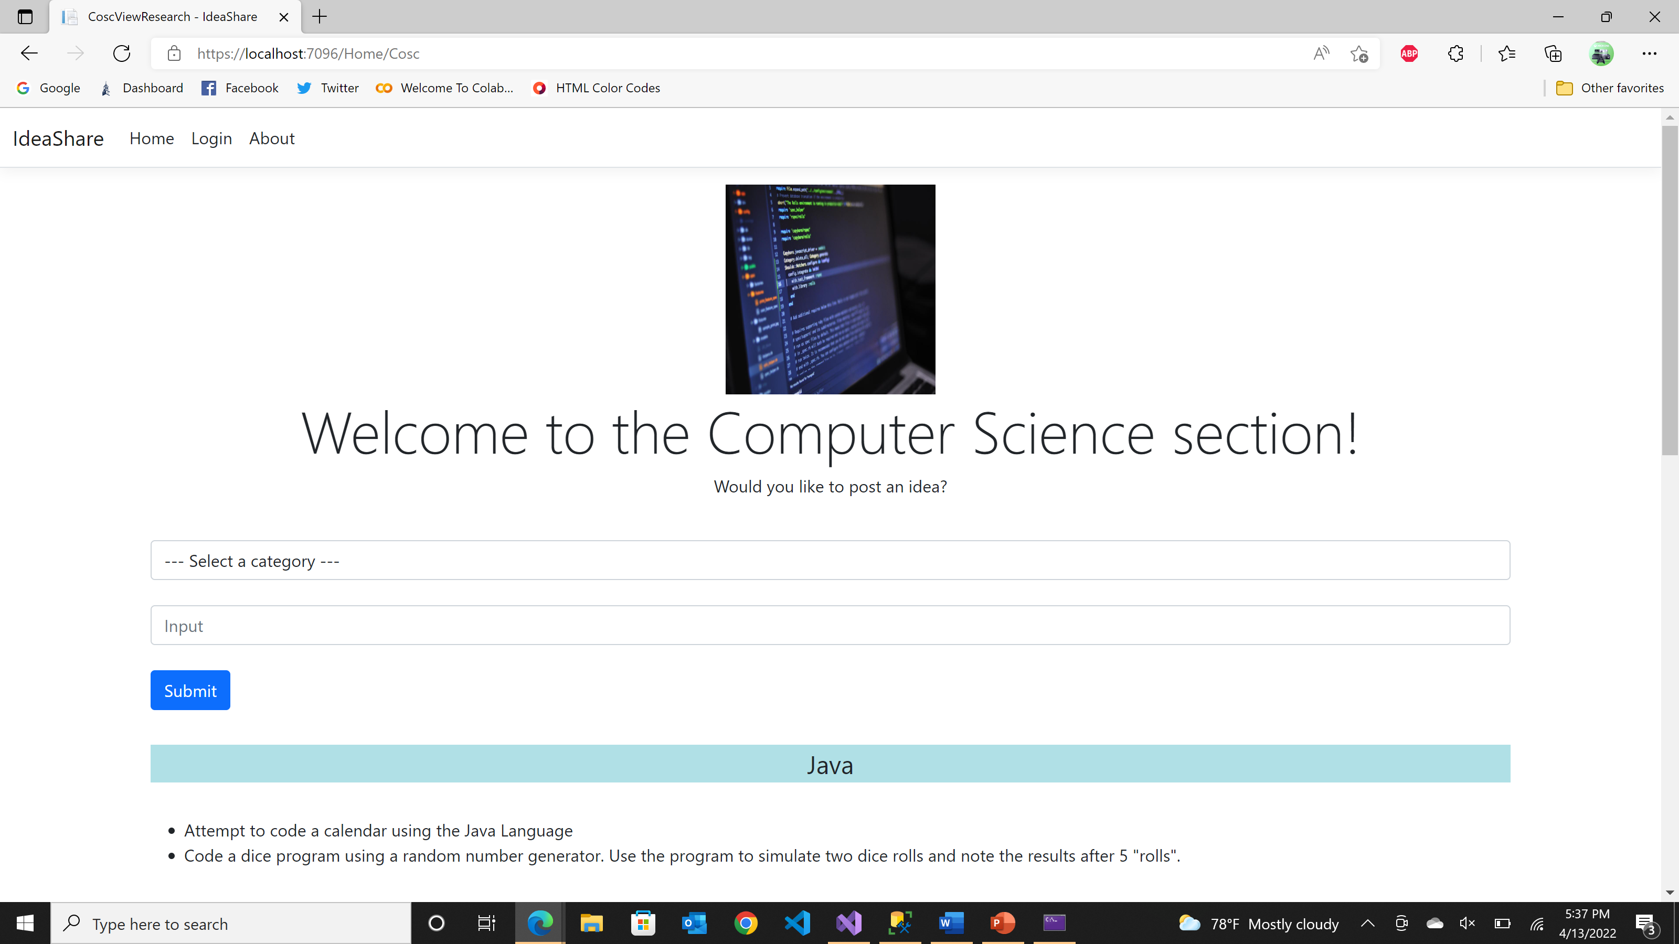
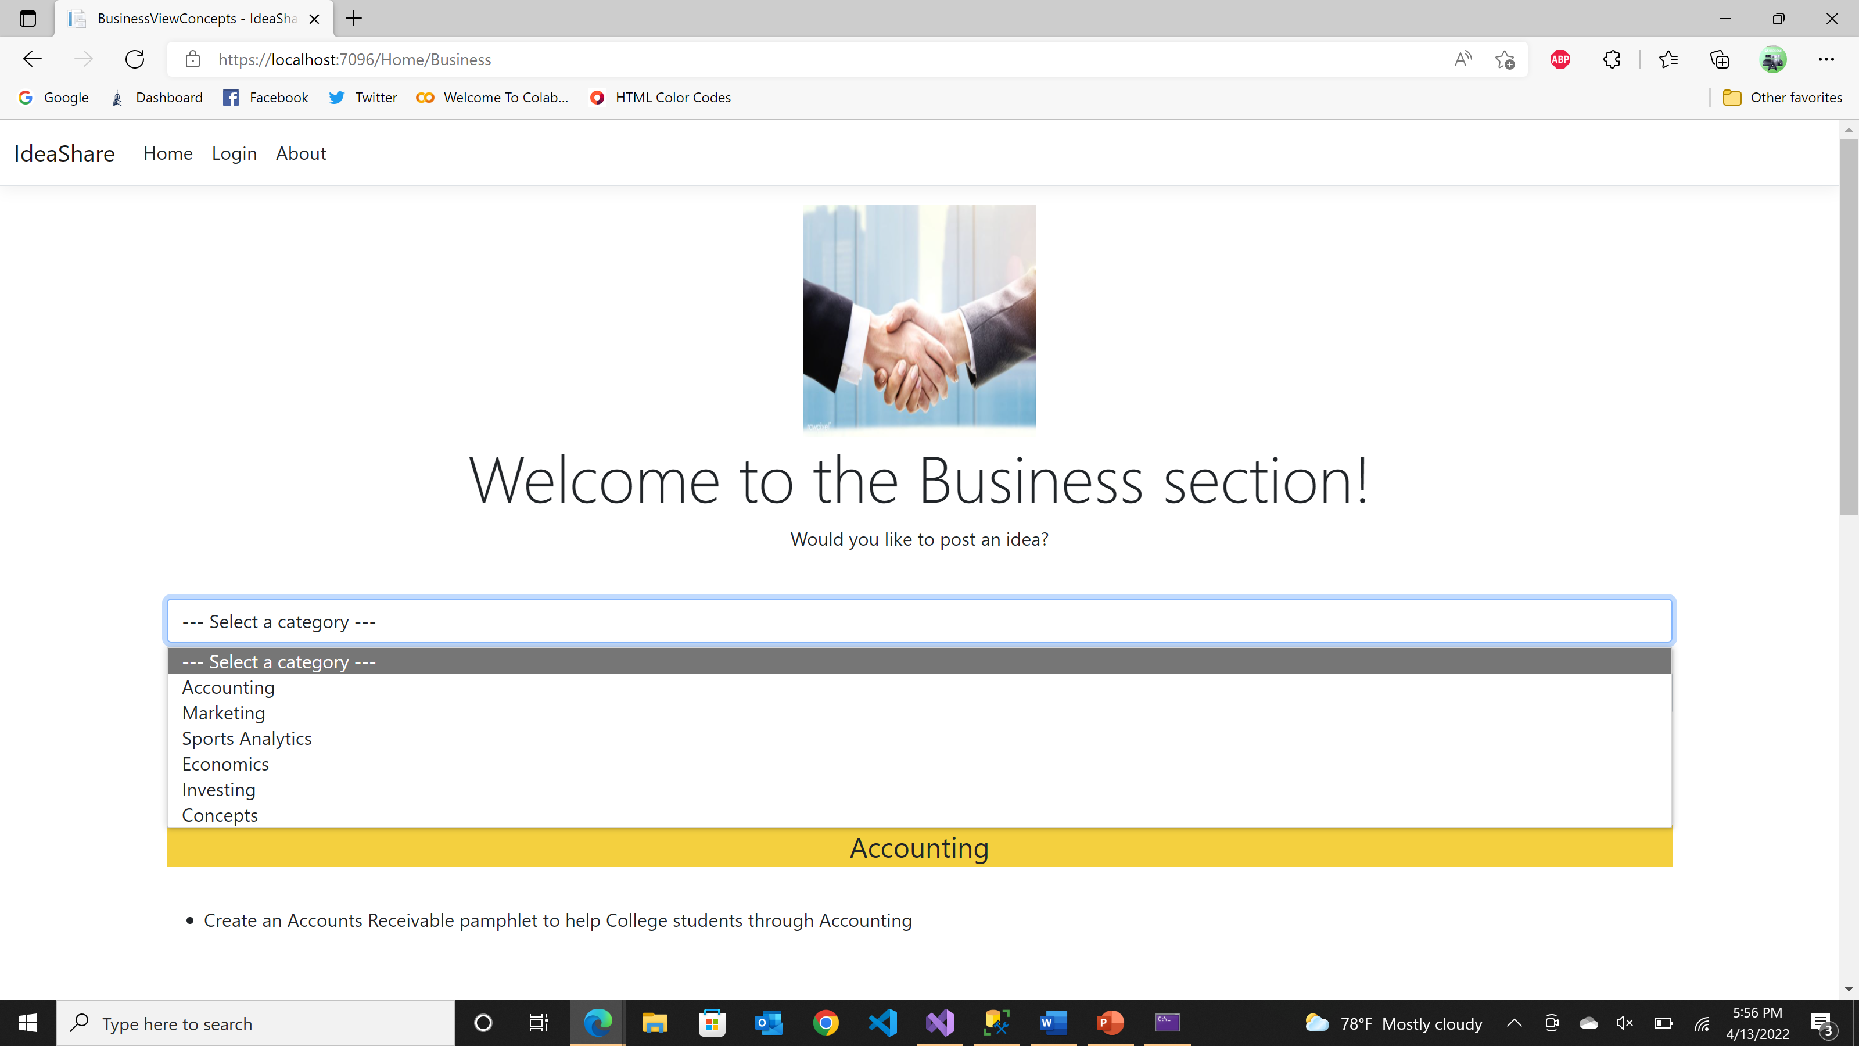
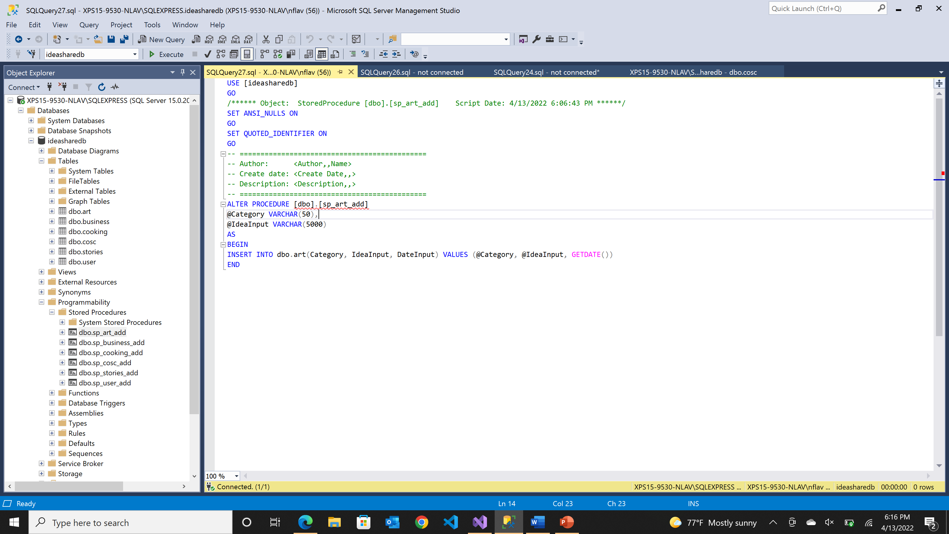
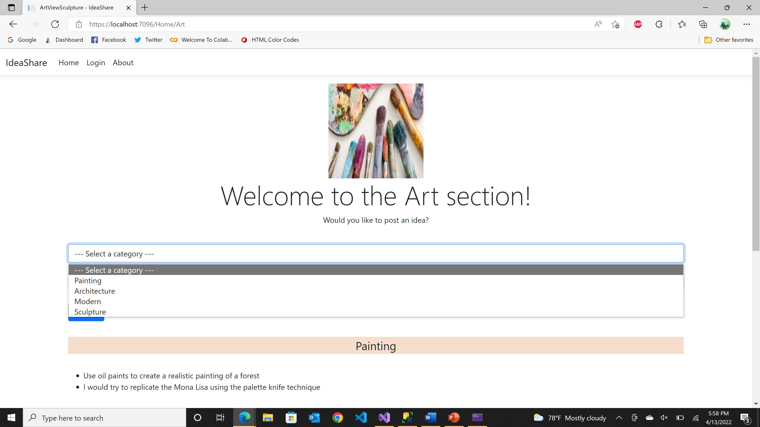
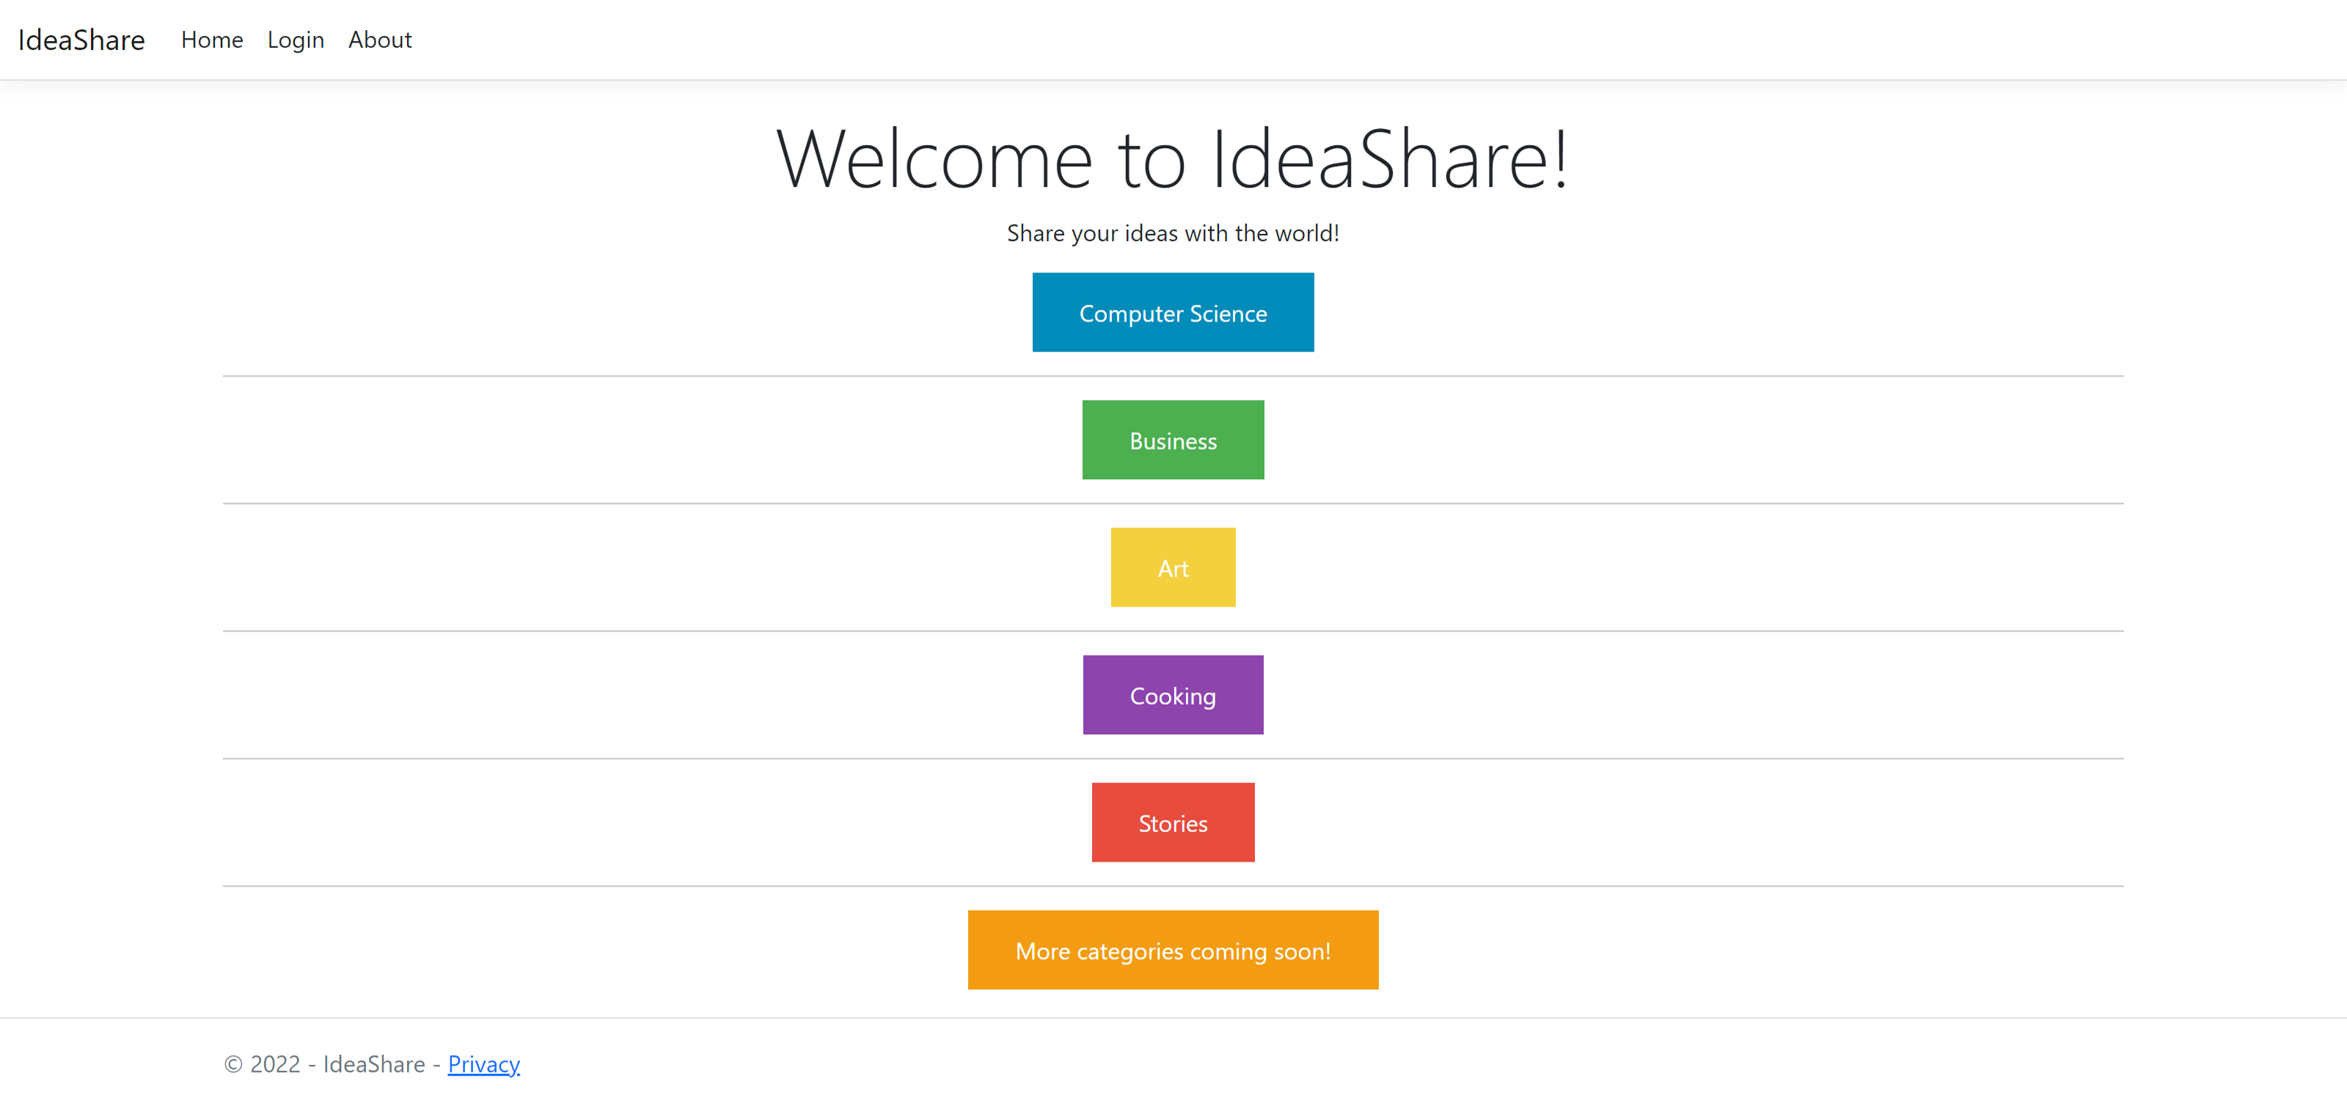
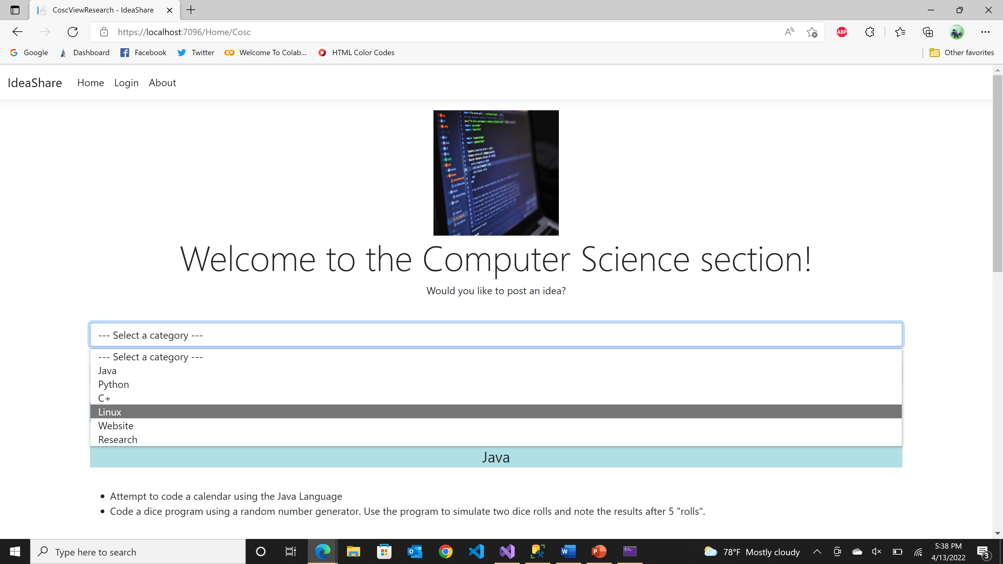
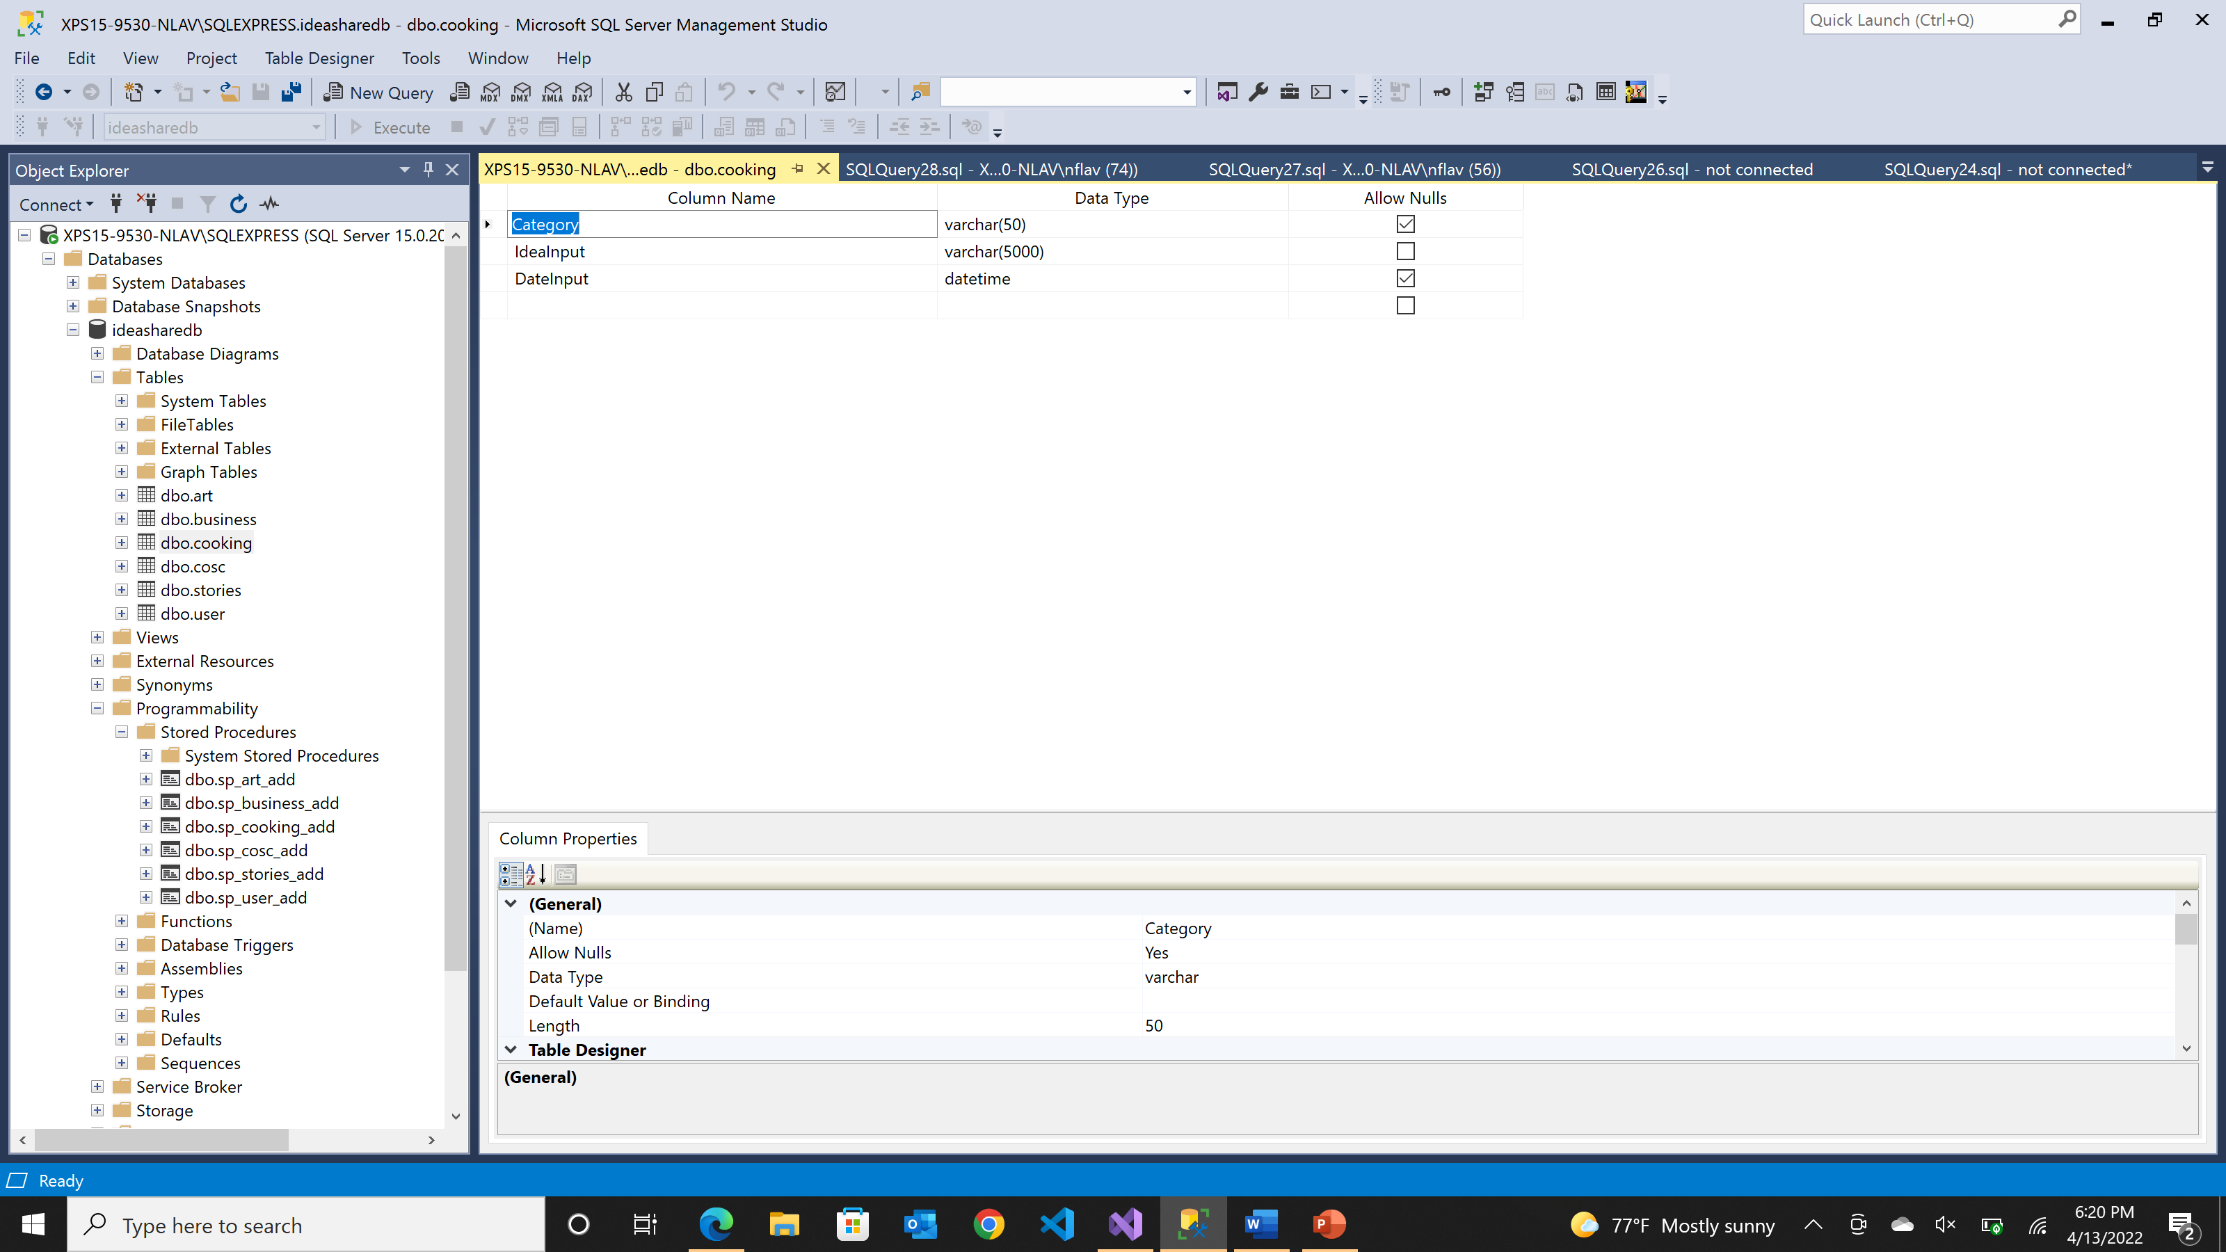
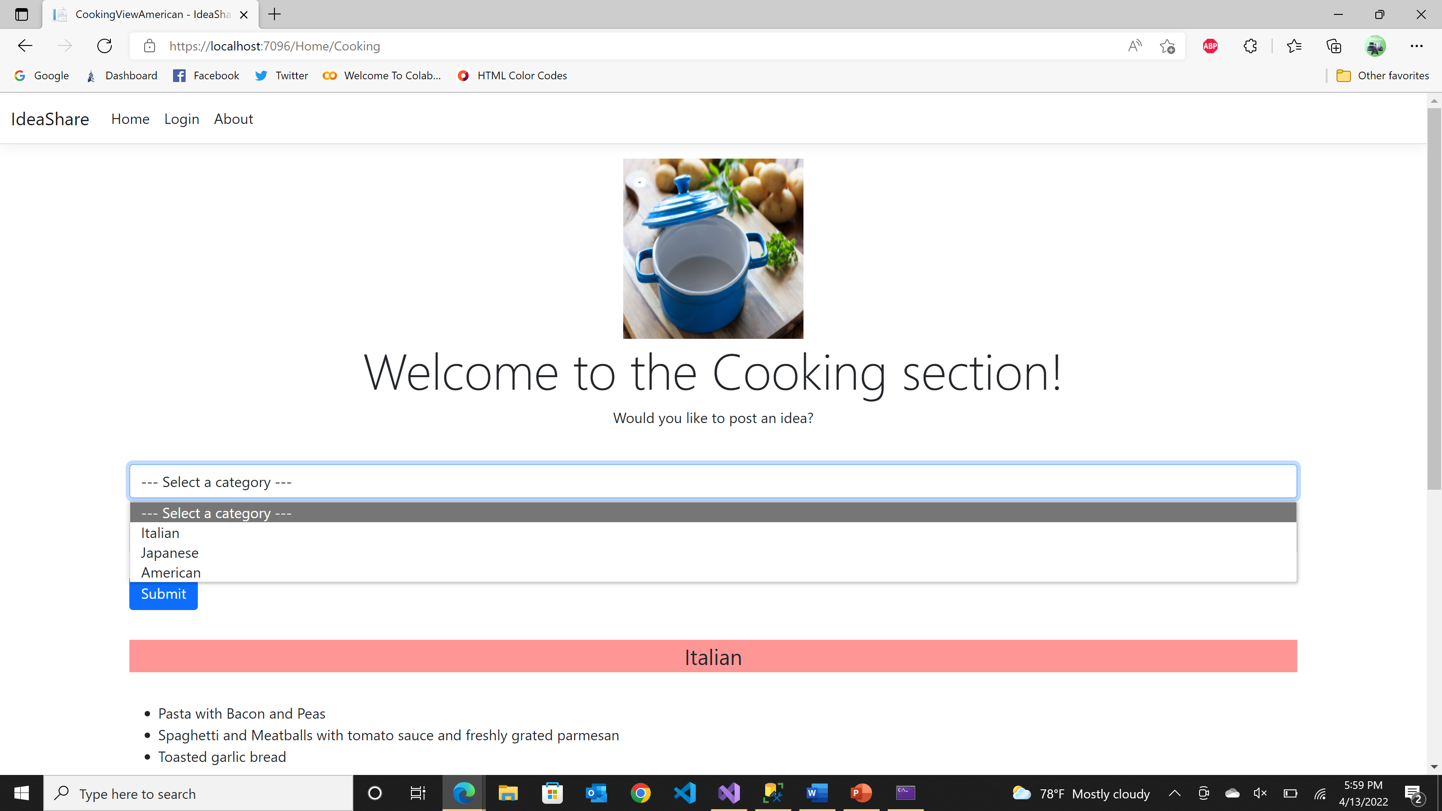
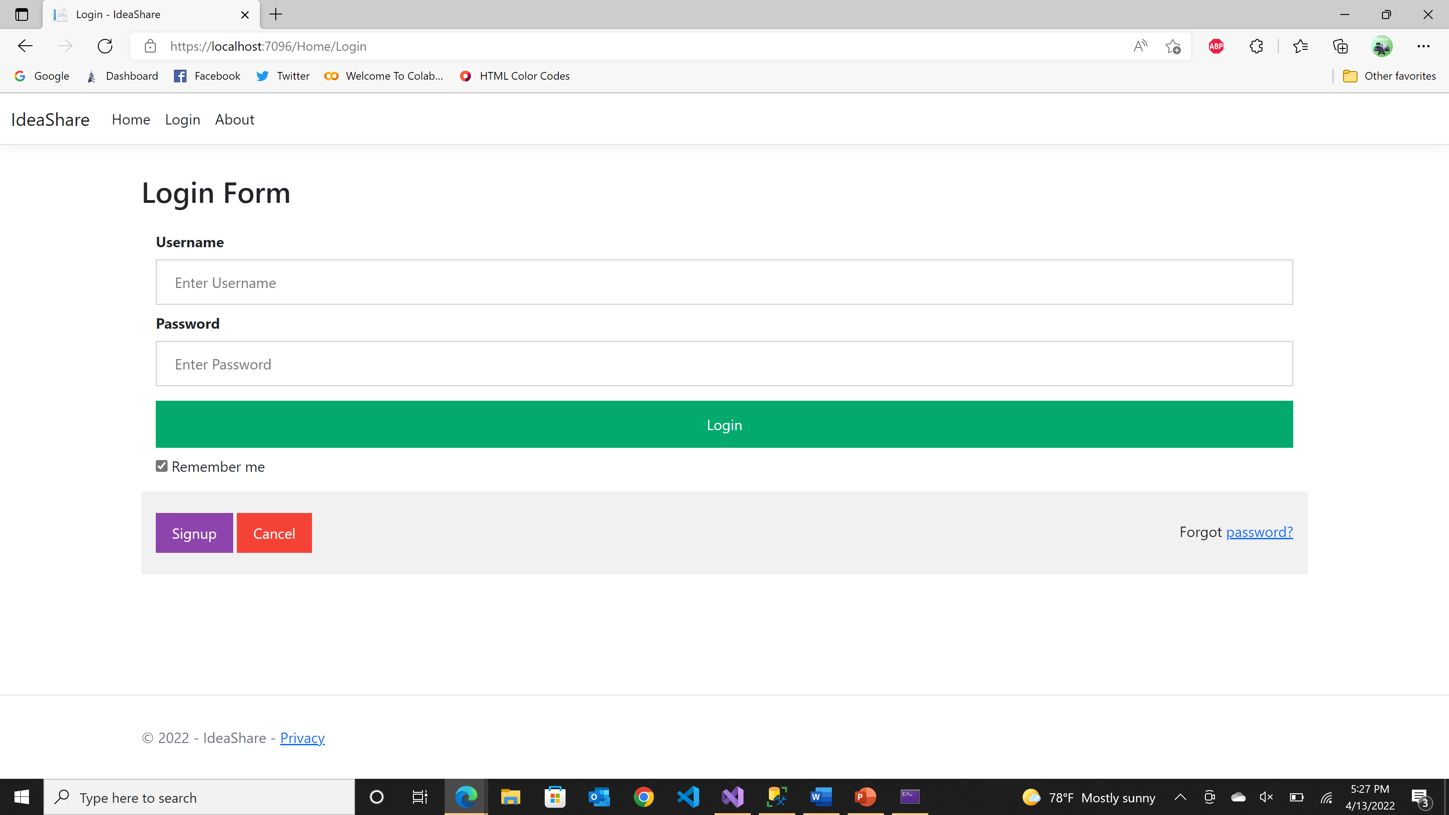
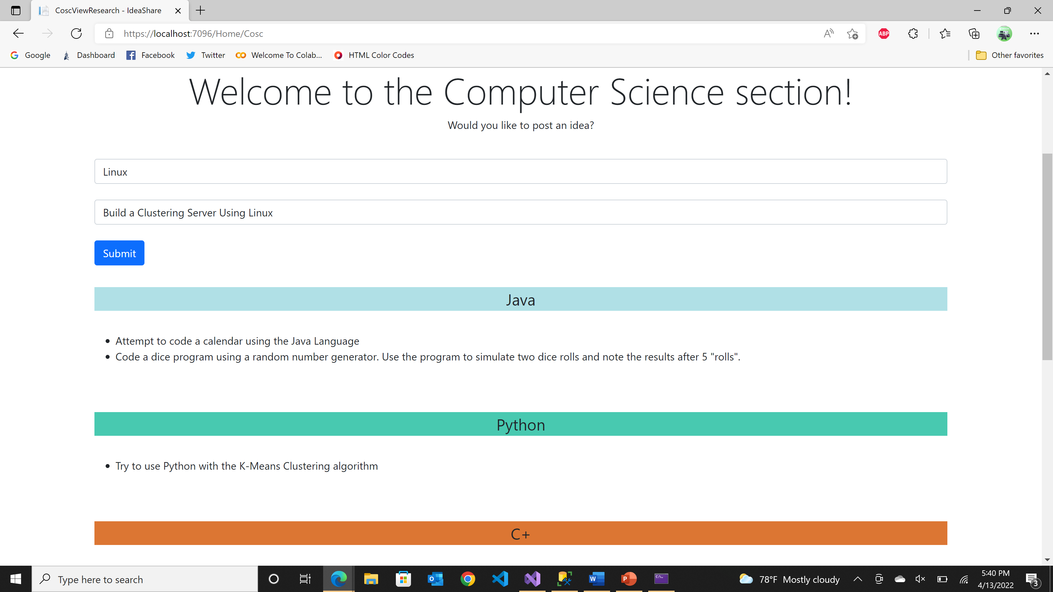
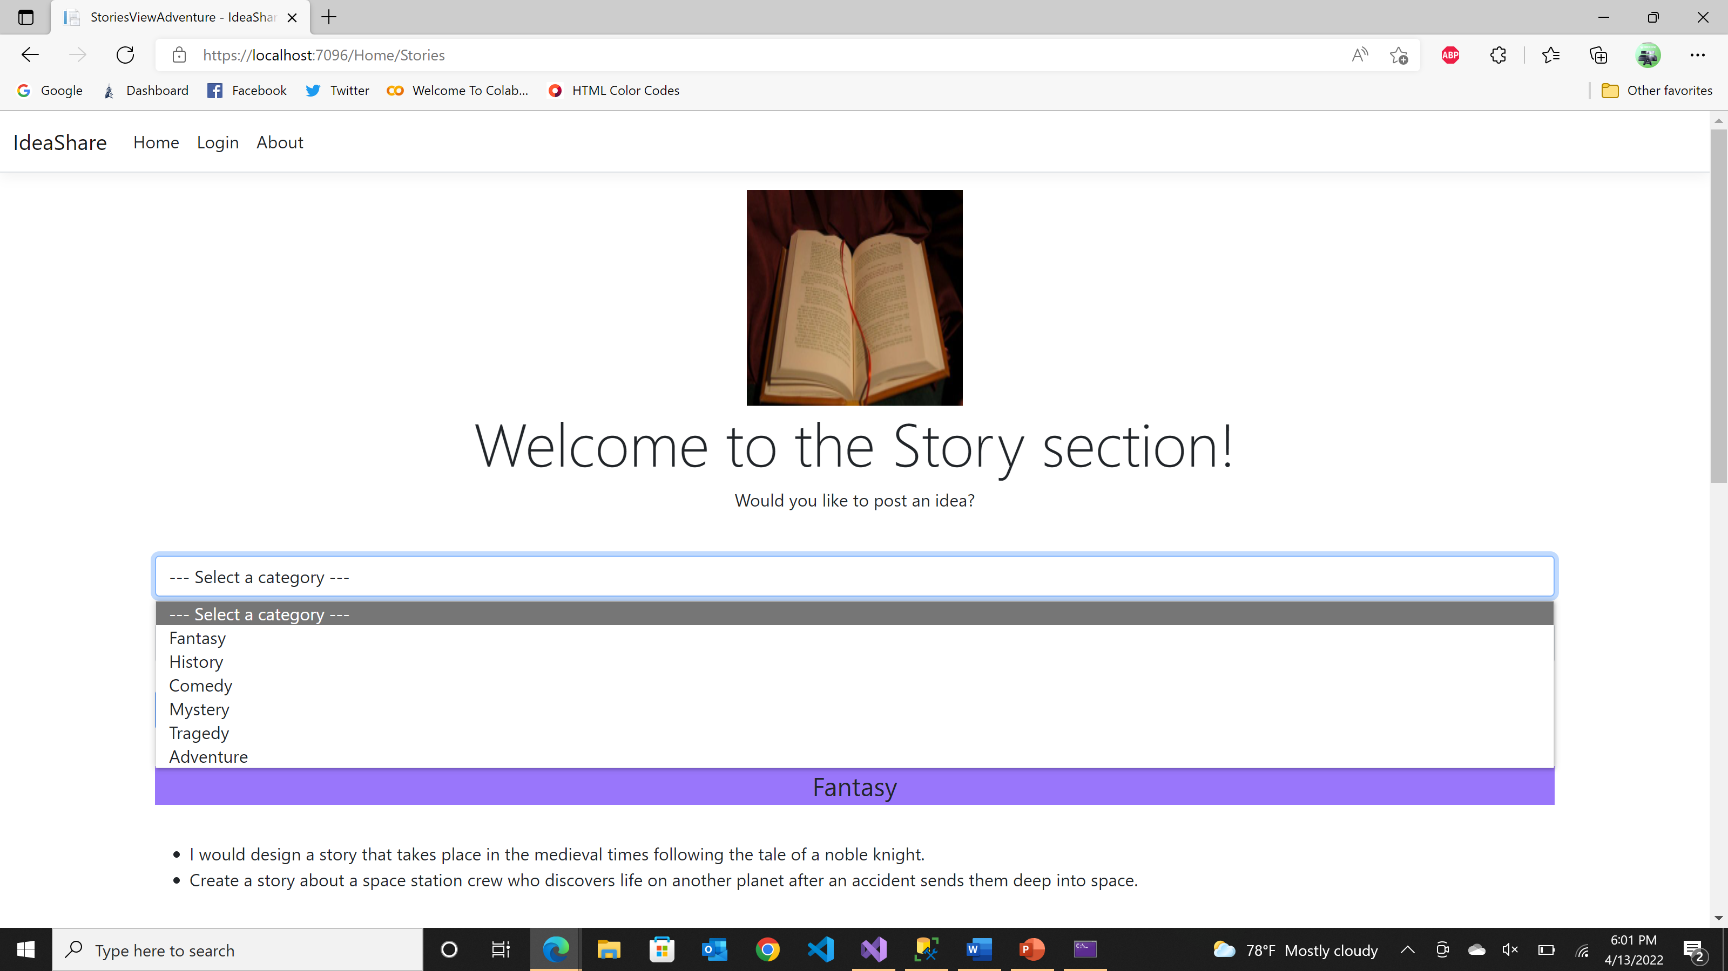
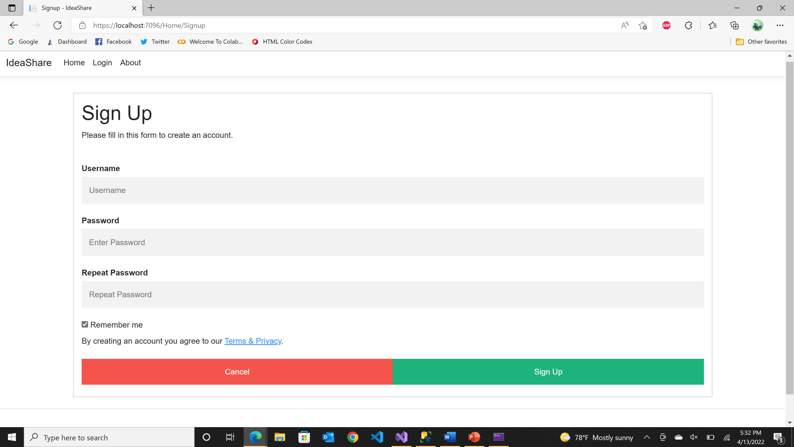
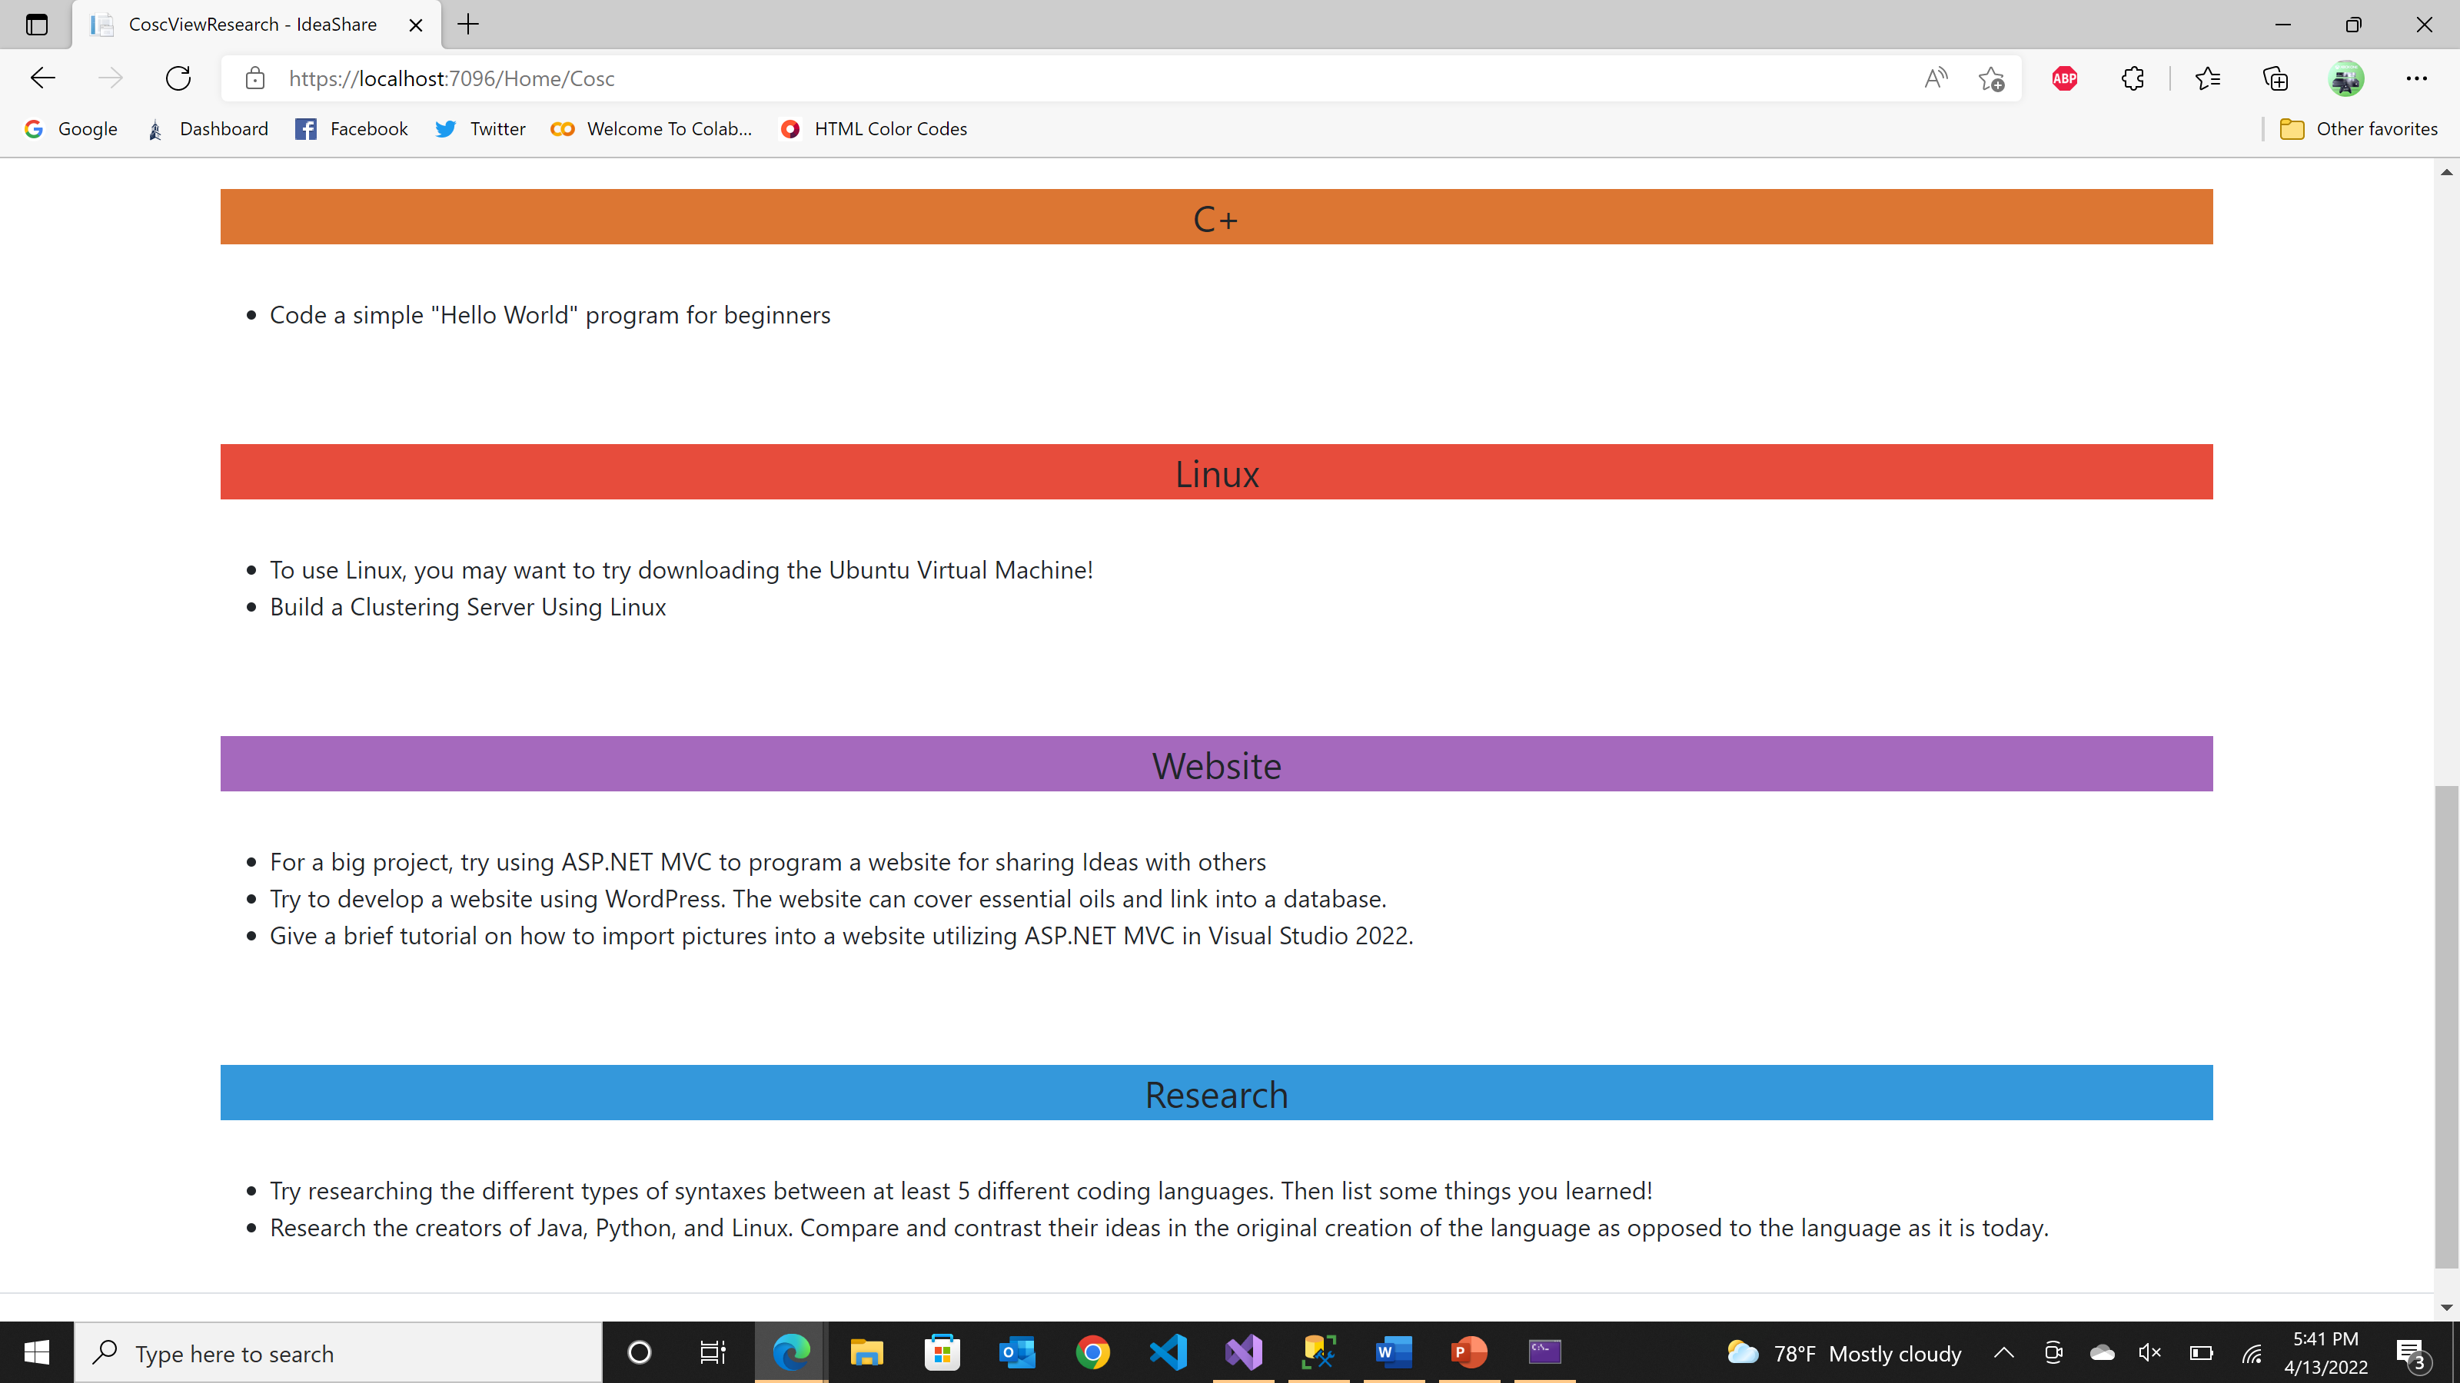

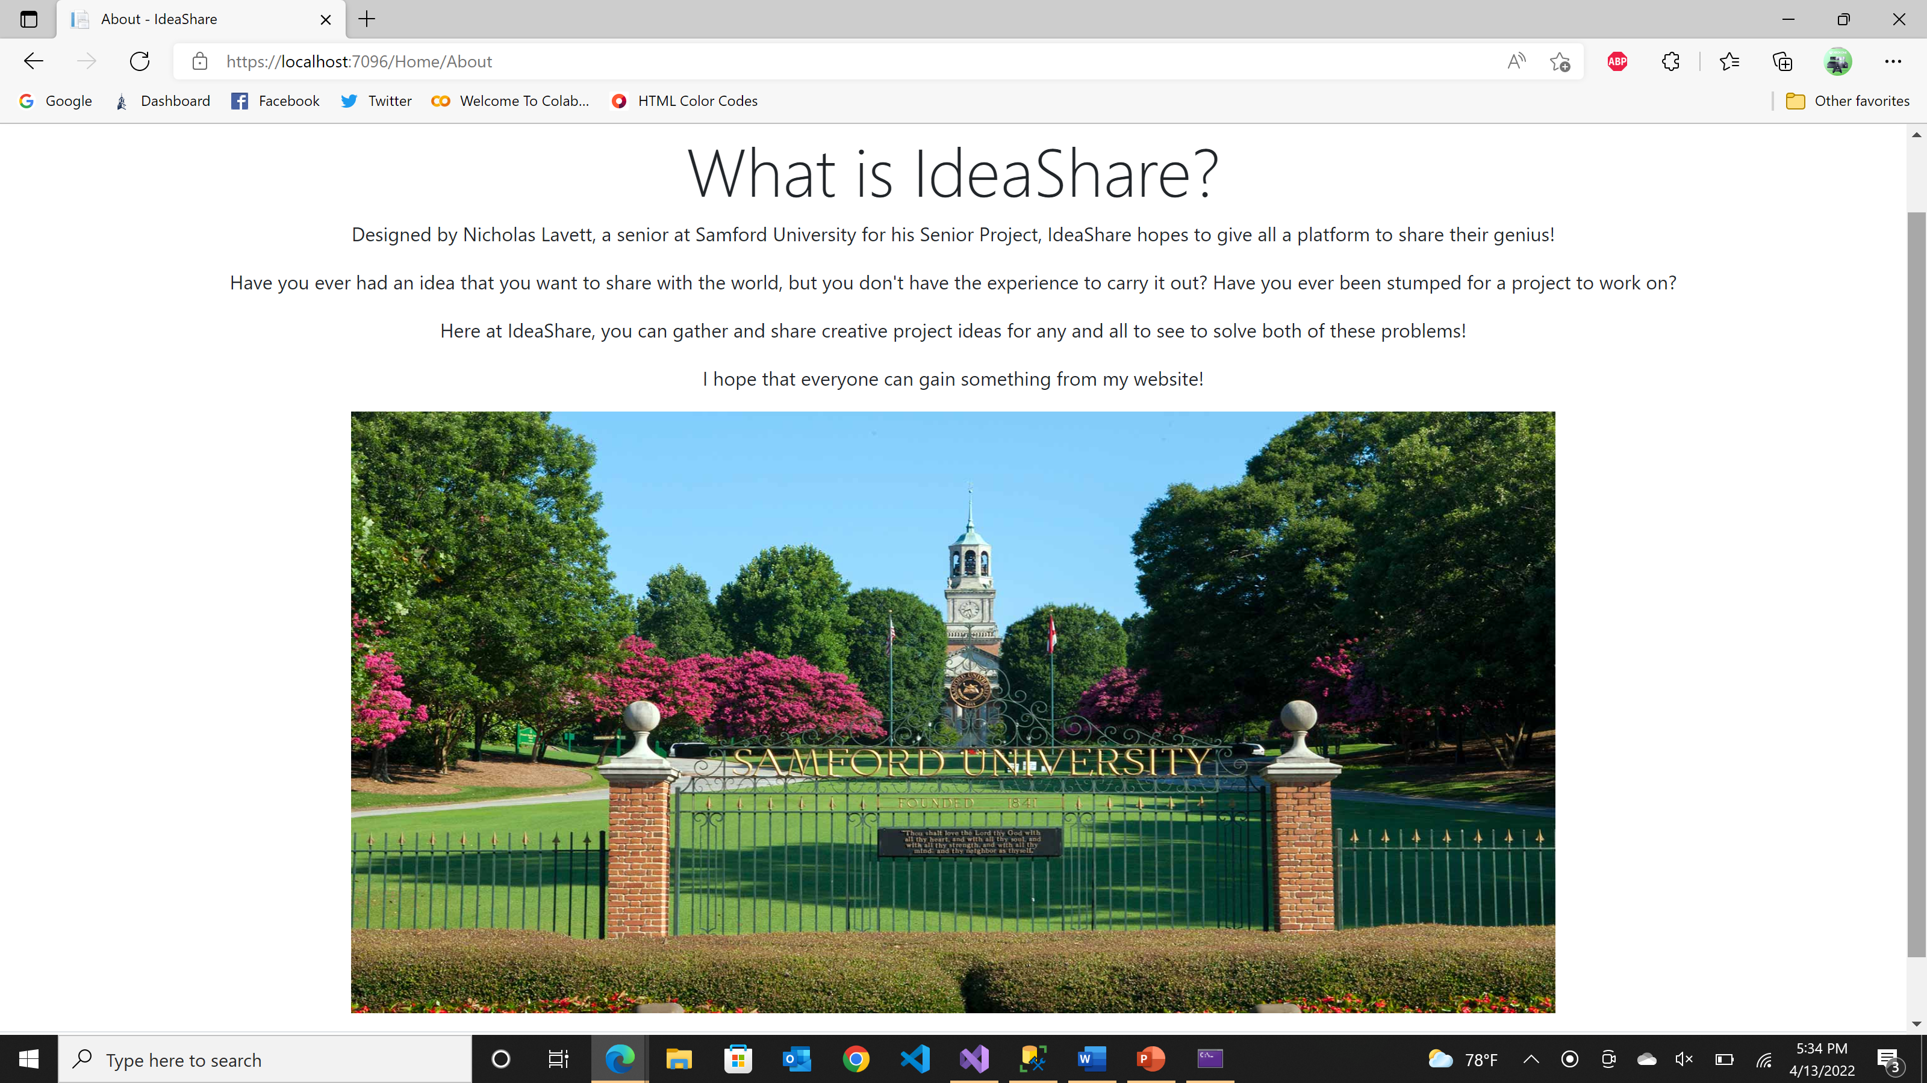


The Value of Ideas: IdeaShare Website
By: Nicholas F. Lavett, Mentor: Brian Toone
Computer Science Department
Introduction/Abstract
Functionality
All Categories
Back End Database
For my Senior project, I took it upon myself to design a website using ASP.NET MVC and a SQL Server database. The purpose of this project is to gain knowledge and experience in web development and share lessons learned along the way. IdeaShare is a place for others to post and derive inspiration from others. Users can post ideas for projects under suggested categories for other users to implement or gain inspiration from.
Front End Designs
Users select a Category such as Computer Science on the Home Screen.
Users then select a topic such as Linux from the drop-down selection box.
Results
IdeaShare is a functioning website that allows the posting and viewing of ideas ranging from Computer Science to Art and more. With the open concept of the website, there is always room to add more categories and topics to inspire others.
In the development of my website, I was able to gain knowledge and experience and learn new technology from the ground up. From designing the front end within Visual Studio utilizing ASP.NET MVC to establishing a back end connection with the database inside of SQL Server, I truly feel like I accomplished a clean and efficient website design.
I believe that I will be able to take the experience I learned through this project and put it to good use in my future career.
Once a topic has been selected, the user can enter their idea and submit it for others to view.
Tools/Resources
.
Acknowledgements
I would like to provide a special thanks to
Dr. Brian Toone for his mentorship, overseeing of the project development, and his help on the completion of IdeaShare. Additional thanks to the entire Computer Science Department as well.
Upon submission, the idea is saved to a database and posted on the page under the correct topic.

